Slide 1
Stance detection for a low-resource language
Ahmad Mustapha Wali, Alexandru Ștefan Ghiță,
Lara Tomeh, Radu Puținelu

Slide 2
Abstract
Stance detection is defined as automatically determining whether the author of a piece of text supports or opposes a given target. For a variety of social and political applications where sentiment analysis may be inadequate, stance detection on social media is an emerging opinion mining paradigm. For this project, we experimented with stance detection for Zulu, a low-resource language, using several BERT-based models to observe how it compares to a previous approach to the same task that was solved using ULMFiT.

Slide 3
Introduction
Stance detection on social media is being used for a range of social and political applications where sentiment analysis may not be sufficient. A speaker's stance is an indication of their perspective and assessment on a certain topic. Analysis studies gauging public opinion on social media, particularly on political and social matters, heavily rely on stance detection. These topics tend to be divisive in nature, with people expressing conflicting viewpoints on matters like politics, religion, the legality of abortion etc.

Slide 4
Introduction
As sentiment analysis is not always enough in certain circumstances, stance detection offers a more complex and thorough knowledge of the author's viewpoint. The goal of this study was to apply stance detection to Zulu, a language with limited data and computational tools. To evaluate the efficacy of this strategy, a number of BERT-based models were tested and compared to a previous solution that used Universal Language Model Fine-tuning (ULMFiT). The aim was to investigate how these various models worked and which one was most successful in solving the problem of stance identification for Zulu.

Slide 5
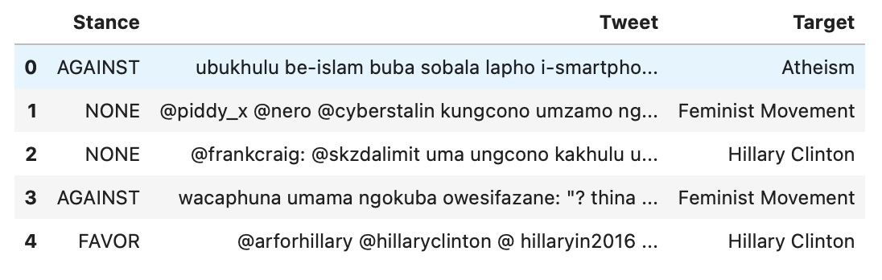
DATA, MODEL & METHODOLOGY
Datasets
1. The Zulu Stance dataset
The Zulu Stance dataset contains text samples in Zulu with annotated stance labels. It is made up of stance labels that represent the stance expressed in five different targets. The dataset consists of 1343 samples and 5 targets and is a subset of the SemEval-2016 Stance Dataset translated to Zulu using Google's Translate API.

Slide 6
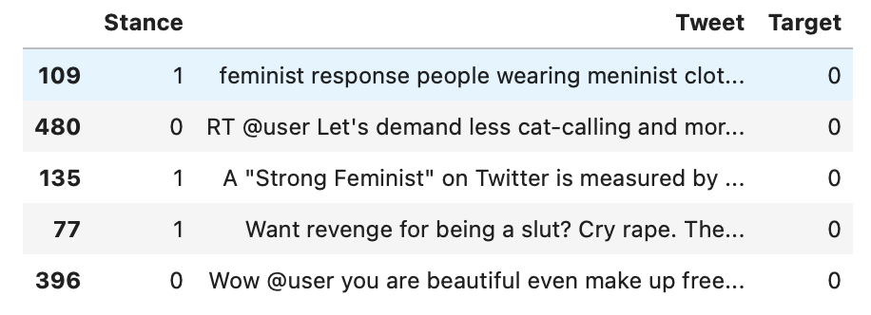
DATA, MODEL & METHODOLOGY
Datasets
2. The Tweet Eval Stance dataset
The SemEval-2016 Stance Dataset is a collection of English tweets with stance annotations on abortion, climate change, atheism, Hillary Clinton, and feminism. We tried expanding the Zulu Stance dataset with 200 random samples from each topic from the SemEval-2016 Stance Dataset for the project to see how it affects the models. However, only the train split of the dataset was augmented.

Slide 7
Model & Methodology
We used numerous pre-trained BERT-based models for the project. The models were either pre-trained on Zulu or another language in the same family.
XML-R
XLM-R was developed by modifying the XLM-R-large model for masked language models (MLM) use on 17 African languages (Afrikaans, Amharic, Hausa, Igbo, Malagasy, Chichewa, Oromo, Naija, Kinyarwanda, Kirundi, Shona, Somali, Sesotho, Swahili, isiXhosa, Yoruba, and isiZulu), which encompass (Arabic, French, and English).
Multilingual BERT
A masked language modeling (MLM) objective was used to train a model on the top 104 languages with the largest Wikipedia. It was first introduced in this work and made available in this repository. This model was not pretrained on Zulu.

Slide 8
Model | Score (Zulu) Train / Test | Score (Zulu + English) Train / Test
afro-xlmr-base | 0.54935 0.54478 | 0.39561 0.51493
bert-base-multilingual-cased | 0.49069 0.49254 | 0.61958 0.58209
afriberta_large | 0.46276 0.48507 | 0.59643 0.55224
afroxlmr-large-ner-masakhaner-1.0_2.0 | 0.49907 0.52985 | 0.60752 0.52985
xlm-roberta-base-finetuned-zulu | 0.55970 0.57821 | 0.59595 0.55970

Slide 9
CONCLUSIONS, LIMITATIONS & FUTURE WORK
While some of the transformer models fared worse than the ULMFiT model, BERT-based models did better overall, even when not trained on the target language. Additionally, supplementing the dataset with English considerably improved performance for certain models. Because of the scarcity of training data, the performance of all models was constrained. Experimenting with a much larger dataset is a proposal for future work.

Slide 10
Thank you!
Ahmad Mustapha Wali - wrote code and documentation
Alexandru Ștefan Ghiță - wrote code and documentation
Lara Tomeh - wrote code and documentation
Radu Puținelu - wrote code and documentation
N. B. All members of this team contributed equally. For each idea, we discussed and implemented it together.

